Slide 1

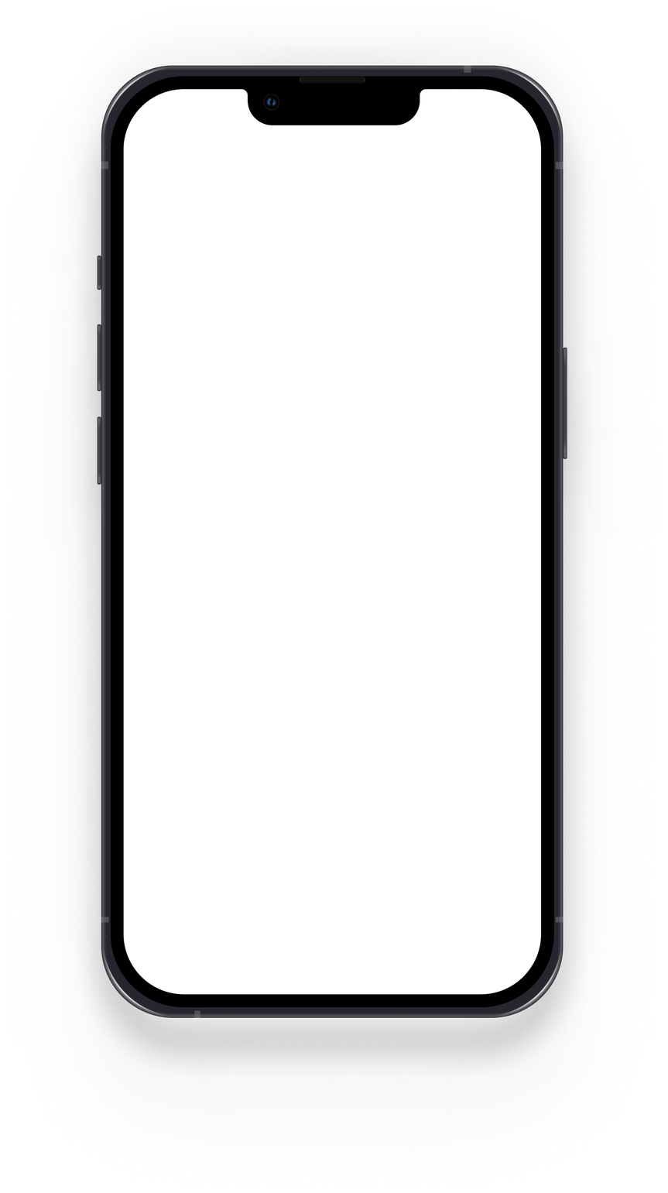
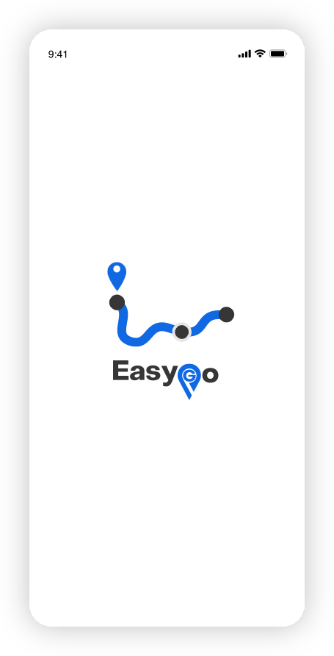

INDOOR NAVIGATION
Capstone B
Presentation
EASYGO - AN EFFICIENT INDOOR NAVIGATION MAP FROM STREAMLINED DATASET WITH SHORTEST PATH DETERMINATION.

Slide 2
Introduction
Our Team
Application Layer
Application user Demonstration
Table of Content

Slide 3
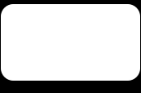





Our Team
Dr. Md Mostofa Kamal Rasel
SUPERVISOR
Assistant Professor
Sakibur Rahaman
Firoz Mahmud Rijve
Kazi Sifat Al Maksud
Anik Dey
2019-3-60-028
2020-1-60-228
2019-2-60-076
2019-3-60-050

Slide 4

MAIN
Contribution
Easy indoor navigation data collection by using mobile
Matrix, Adjacent list, and Edge list here to create an Indoor navigation map we choose Edge list.
Represent navigation data to graph for finding for generating all pair shortest path.
Incorporating navigation data and shortest path in a mobile application indoor navigation.

Slide 5
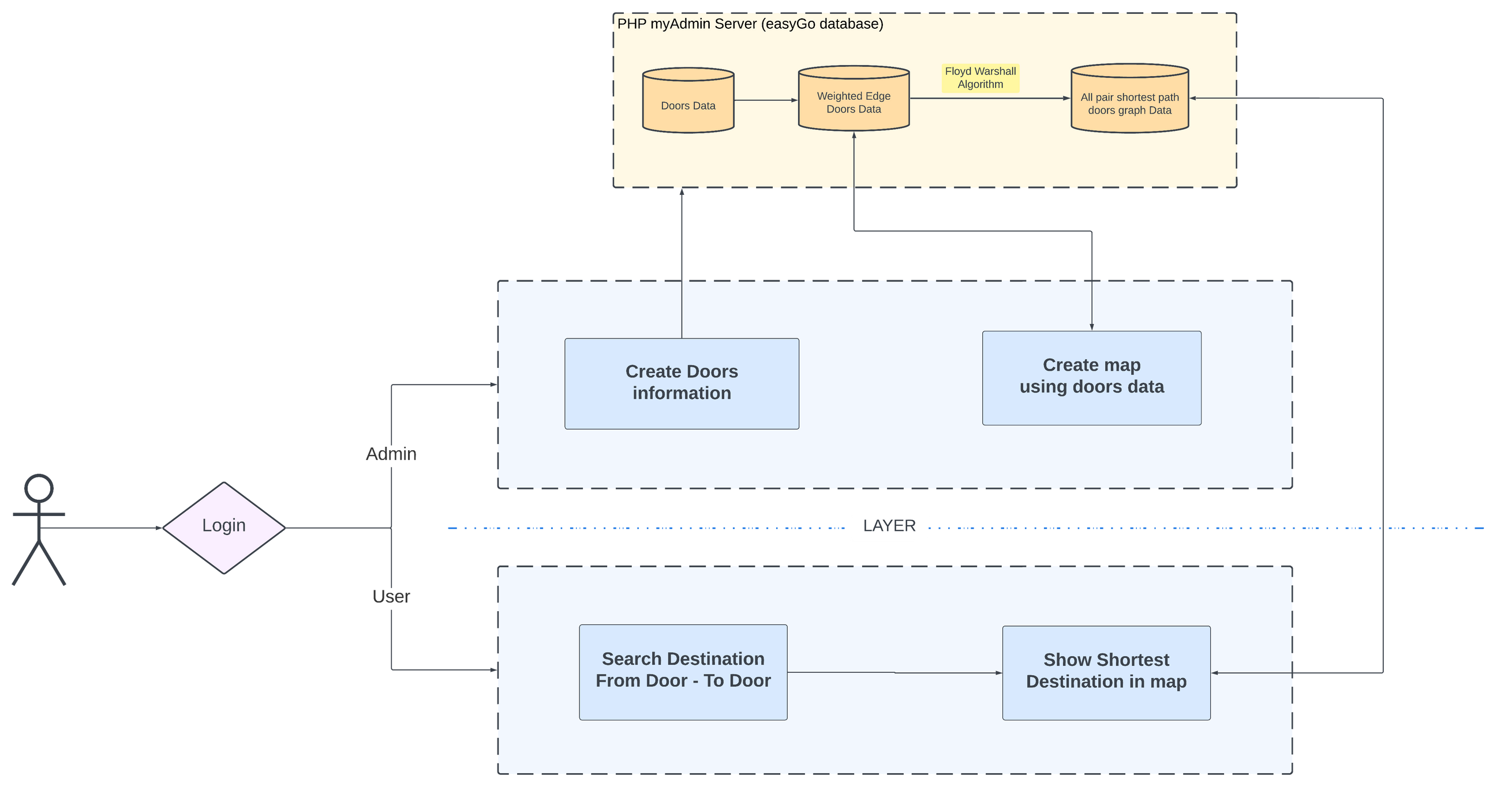
Create Doors information
Create Doors information

Slide 6

Create Doors information
Mobile sensors (accelerometer, gyroscope, and magnetometer) are used to record data while walking door to door.
X, Y, and Z coordinates are collected for positioning floor-wise categorization.
Validated data ensures accuracy and reliability.
Integrated into our indoor navigation system for real-time access.
Continuous research for ongoing improvement.
DOOR DATA

Slide 7

Weighted edged information
Door data is used to create edges between neighboring doors.
Edge weight is determined by the distance between connected doors.
X, Y, and Z coordinate influence distance calculation.
Integrated into our navigation system for efficient routing.
DOOR TO DOOR DATA

Slide 8


Create shortest path
With a weighted edge list, the Floyd-Warshall algorithm calculates all pair's shortest paths graph data for door-to-door combinations.
The algorithm updates path distances efficiently, considering intermediate doors.
This data integration enhances our indoor navigation system, providing optimal routes for users.

Slide 9



Challenges Overcome
01
SENSOR ERRORS
Ensuring accurate data collection from mobile sensors (gyroscope, accelerometer, magnetometer) despite phone shake or movement.
02
Loop Handling
Preventing the creation of duplicate nodes and managing loops effectively in the indoor map.
03
Real-time Database Efficiency
Overcoming limitations in running the Floyd-Warshall algorithm on the real-time database due to large data volume.

Slide 10



Challenge
Challenges Overcome
04
SHORTEST PATH COMPUTATION
Calculating and storing all pairs of shortest paths between doors for efficient navigation.
05
Database Management
Ensuring efficient data storage and retrieval while maintaining the integrity of the indoor navigation system.
06
User Experience
Delivering a seamless and user-friendly navigation experience, considering varying indoor environments and user preferences.

Slide 11
App UI Visualiztion
READY TO SHOWCASE

Slide 12
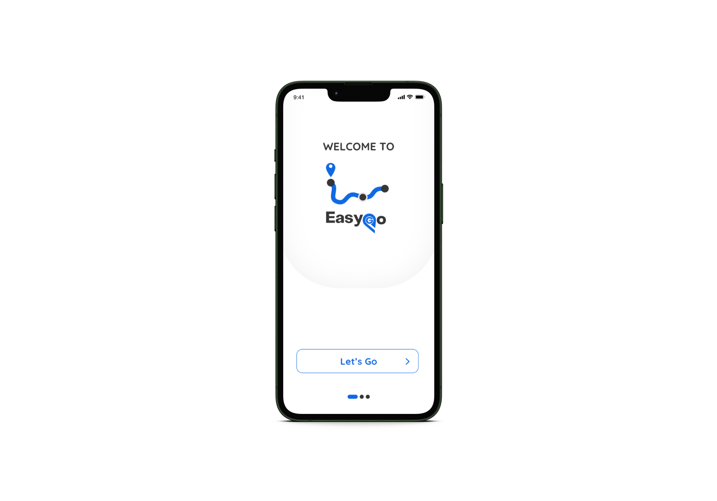
STEP 1
PRESS START BUTTON

Slide 13
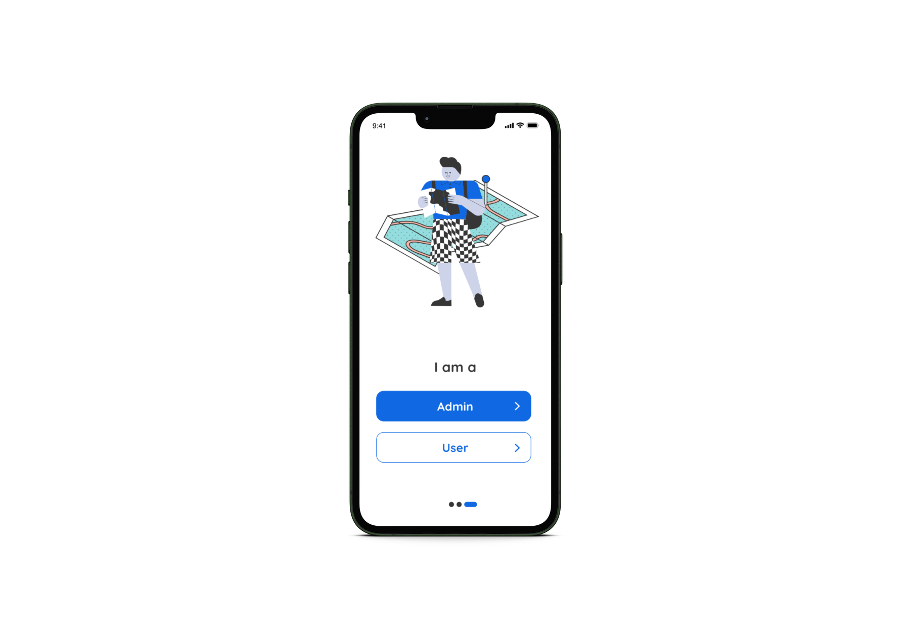
STEP 2
ADMIN
Do you want to make an indoor map for your building?
Start as a Admin
USER
Are you stuck in a building?
Start as a User
STEP 1

Slide 14
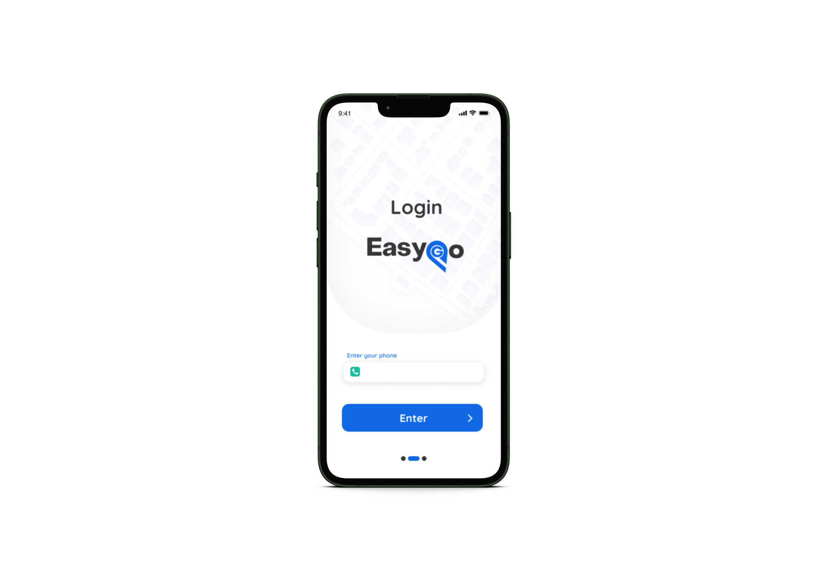
STEP 3
ADMIN
ENTER YOUR NUMBER
STEP 2
PRESS ENTER
STEP 1

Slide 15
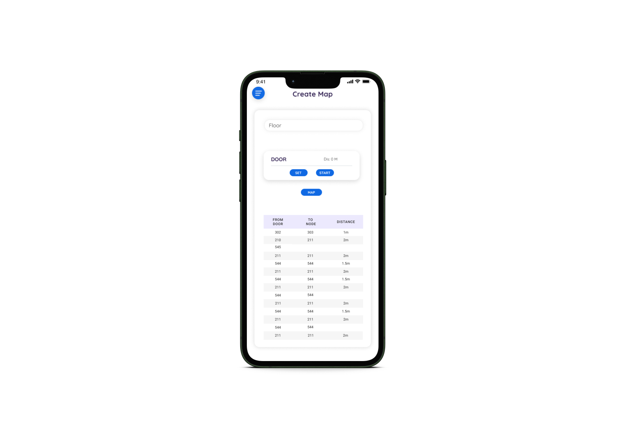
STEP 4
WE CAN TAKE THE FLOOR VALUE
STEP 2
STEP 1
STEP 3

Slide 16
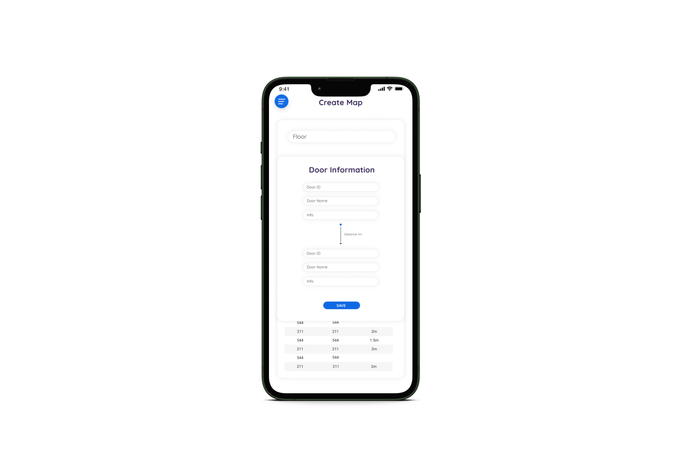
STEP 5
ENTER THE NODE
INFORMATION
STEP 2
STEP 4
STEP 1
STEP 3

Slide 17
STEP 5
CLASS ROOM
302
302
1M
STEP 2
STEP 4
STEP 1
STEP 3

Slide 18
STEP 5
302
303
1M
CLASS ROOM
303
STEP 2
STEP 1
STEP 3

Slide 19
STEP 4
PRESS MAP
STARTING SHOW THE MAP
302
303
1M
STEP 2
STEP 1
STEP 3

Slide 20
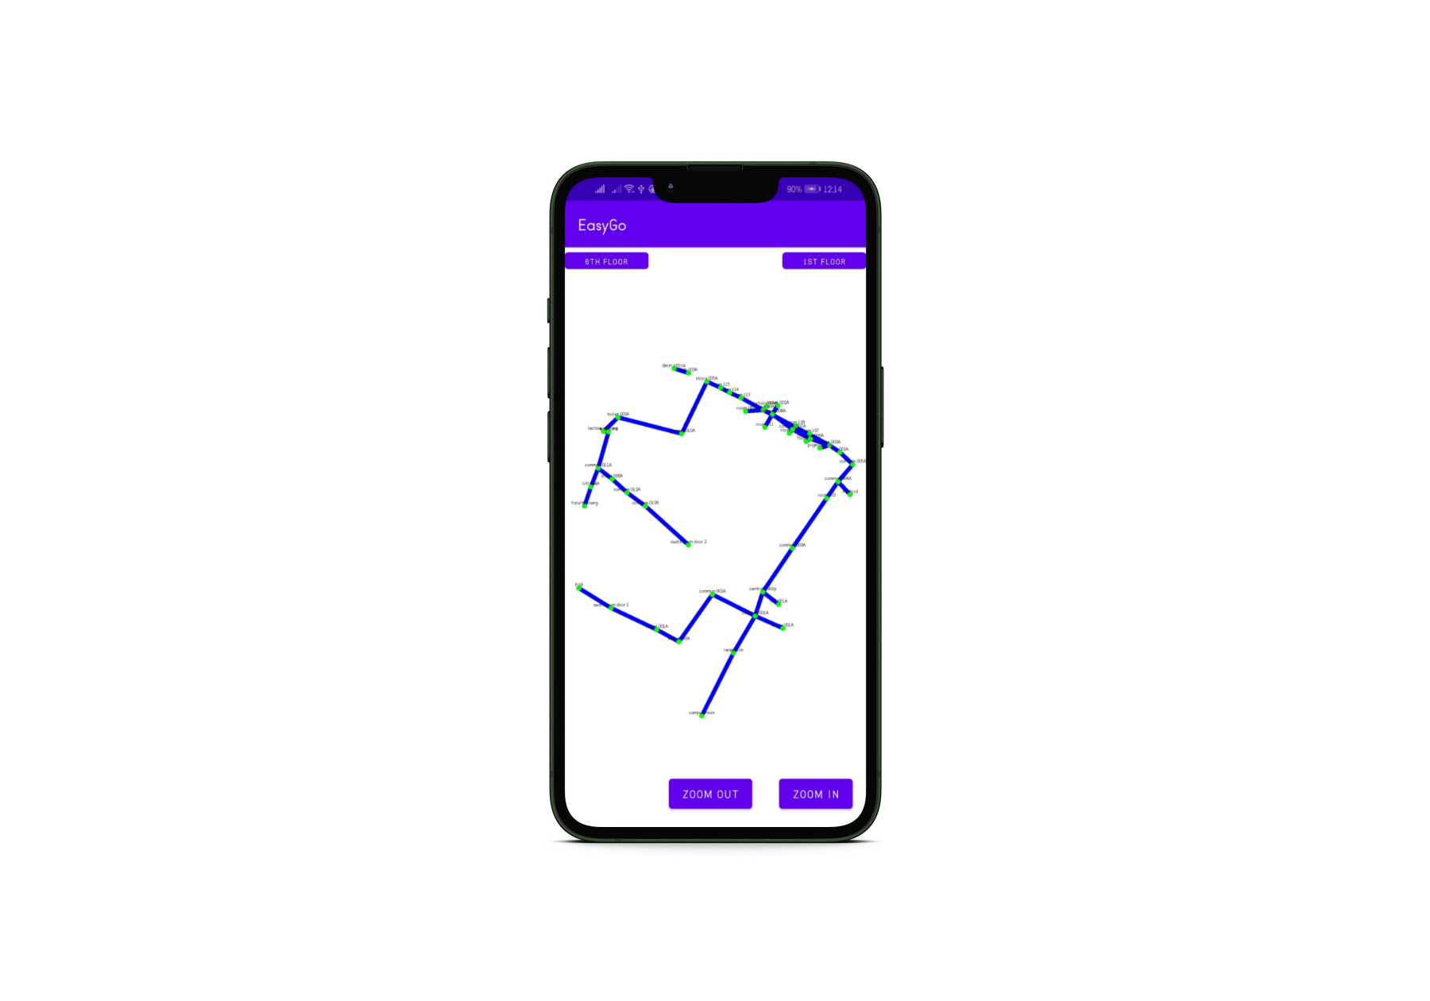
STEP 4
SHOWING MAP
302
303
1M
STEP 2
STEP 1
STEP 3

Slide 21
STEP 3
USER
ENTER YOUR NUMBER
STEP 2
PRESS ENTER
STEP 1

Slide 22
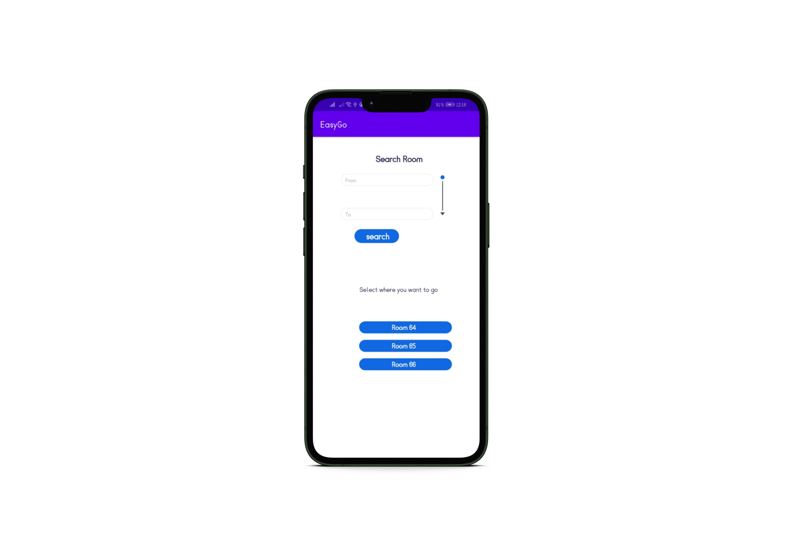
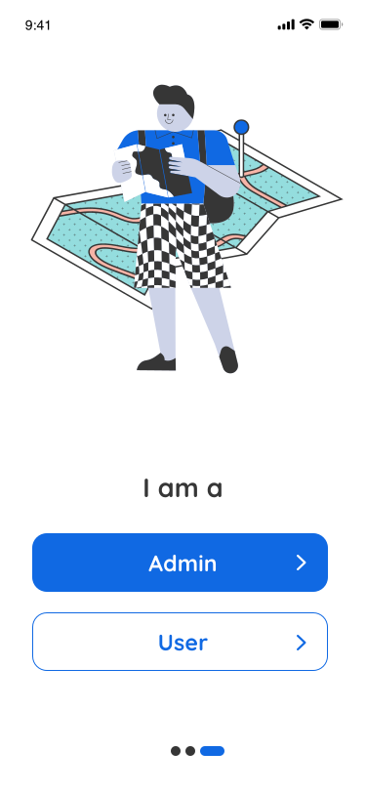
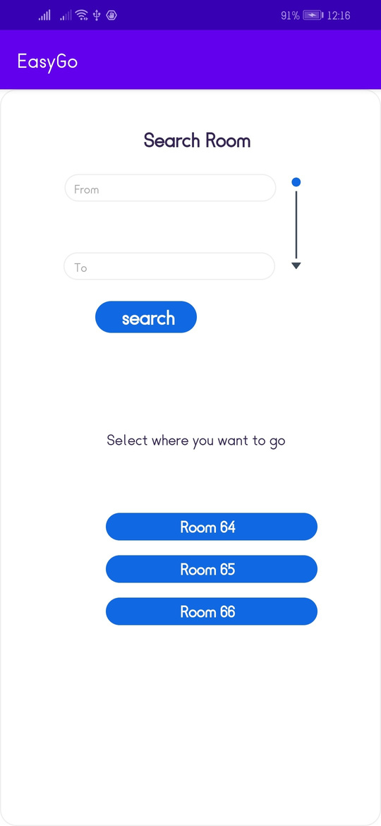
STEP 4
WHERE YOU ARE
CSE department
302
303
1M
STEP 2
STEP 1
STEP 3

Slide 23
STEP 4
CSE department
WHERE YOU WANT GO
room 637
302
303
1M
STEP 2
STEP 1
STEP 3

Slide 24
STEP 4
CSE department
room 637
SEARCH
302
303
1M
STEP 2
STEP 1
STEP 3

Slide 25
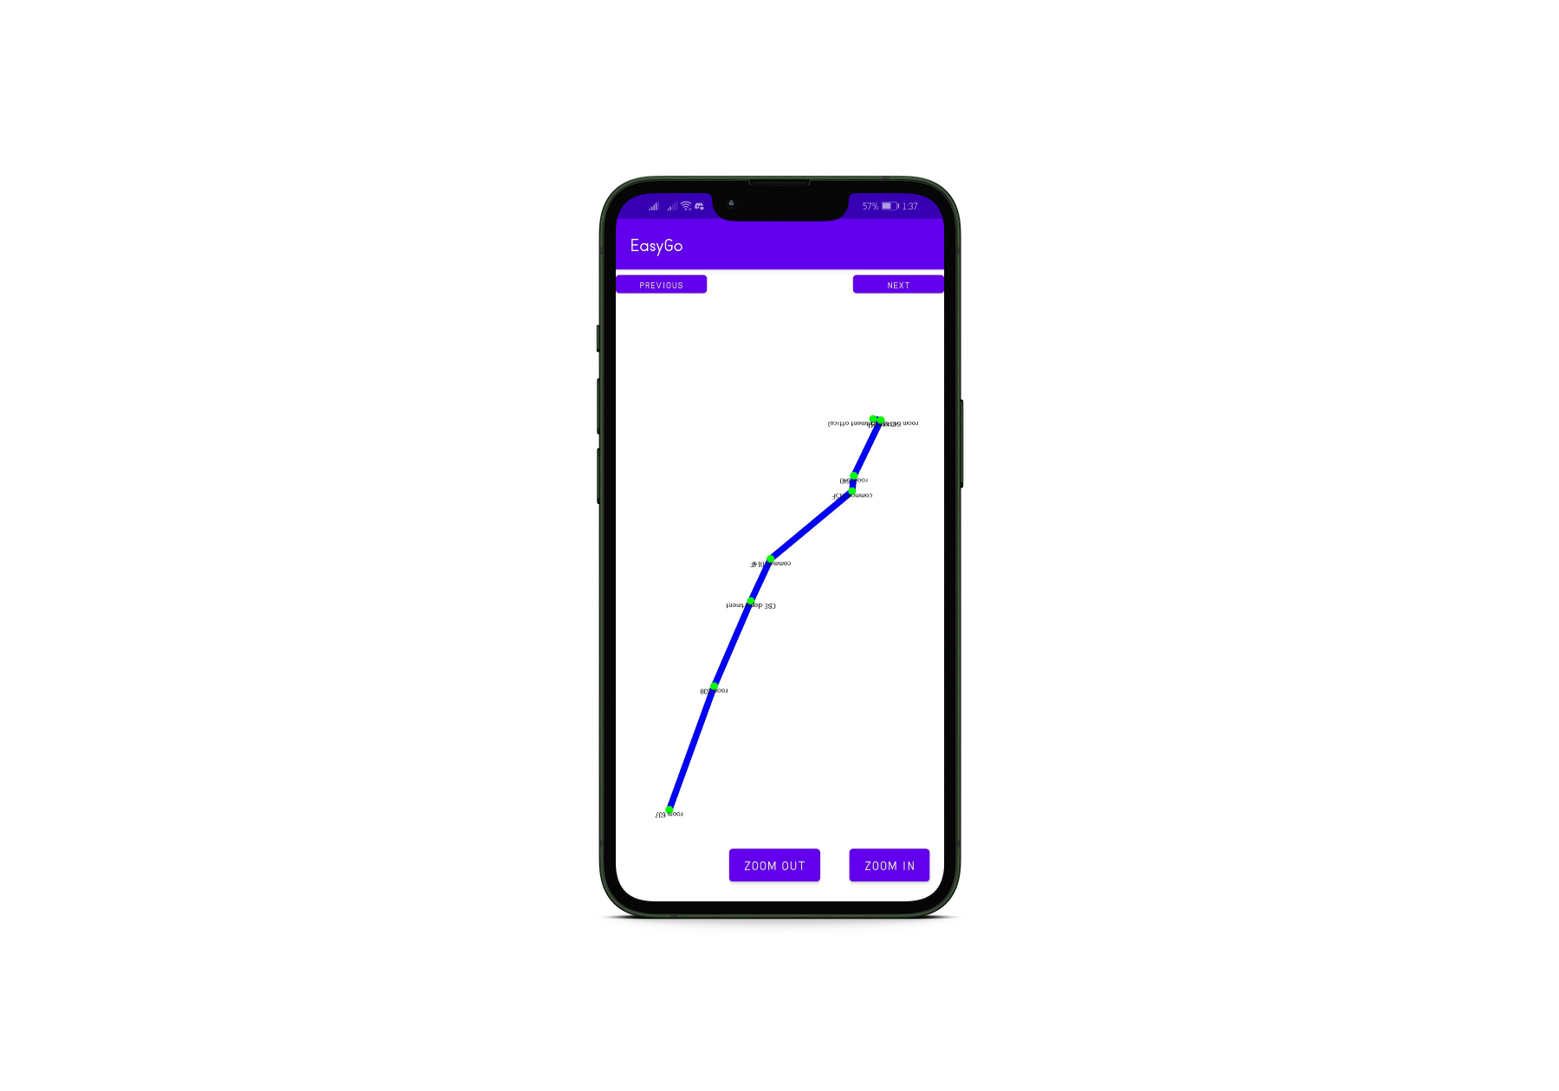
STEP 4
302
303
1M
STEP 2
STEP 1
STEP 3

Slide 26

Future Goals
Enhanced Live Tracking.
More User-friendly User interface.
3D Map Visualization.
Big Data Handling (if needed) .

Slide 27


Thank You

